Slide 1
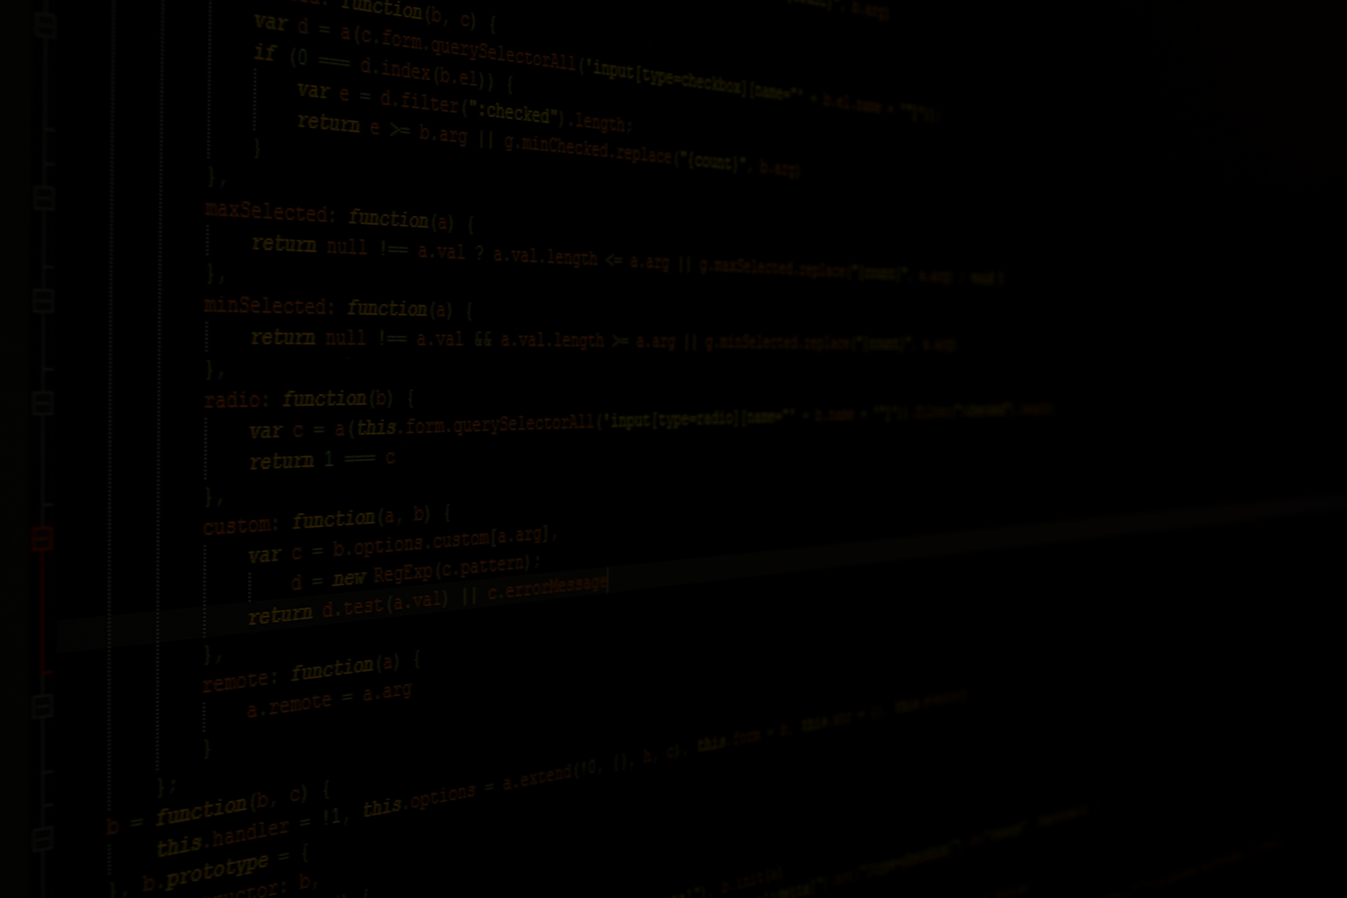
Bus Ticket Reservation and management system
- Aakash Dhakal

Slide 2
Introduction
Bus ticket reservation and management system is a program that manages bus details and helps users to book tickets or reserve seats of the bus
There are two modes of the program :
Admin mode
Can add, remove buses and see information about buses
Passenger mode
Can see available buses, book a ticket and view ticket details

Slide 3
objectives
To provide different functions to different roles of users
To be able to add or remove buses for admins
To be able to reserve seats and view details about their tickets for passengers

Slide 4
Features
Add and Remove buses
View available buses at the time
Reserve a seat on the bus
View the details of the ticket after reservation

Slide 5
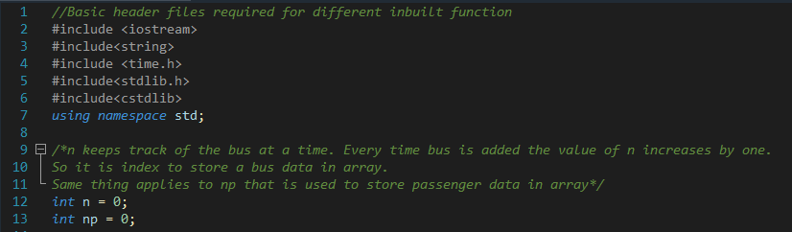
Coding

Slide 6
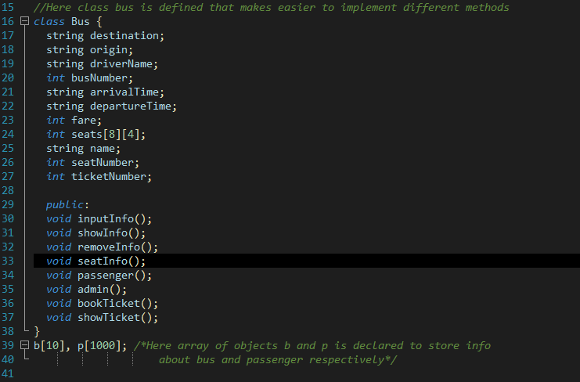

Slide 7
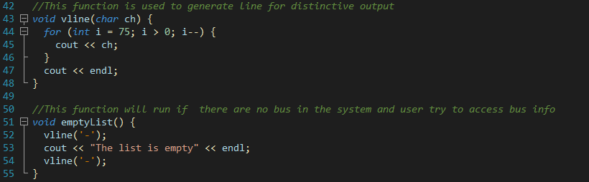
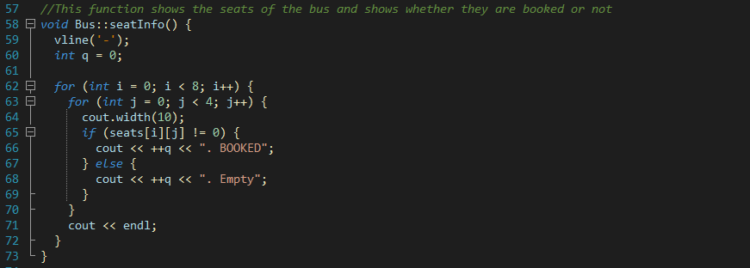

Slide 8
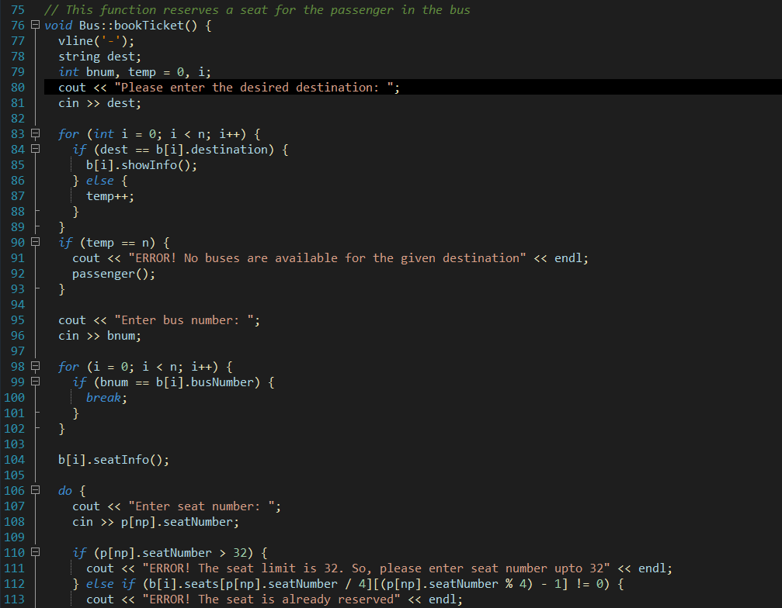

Slide 9
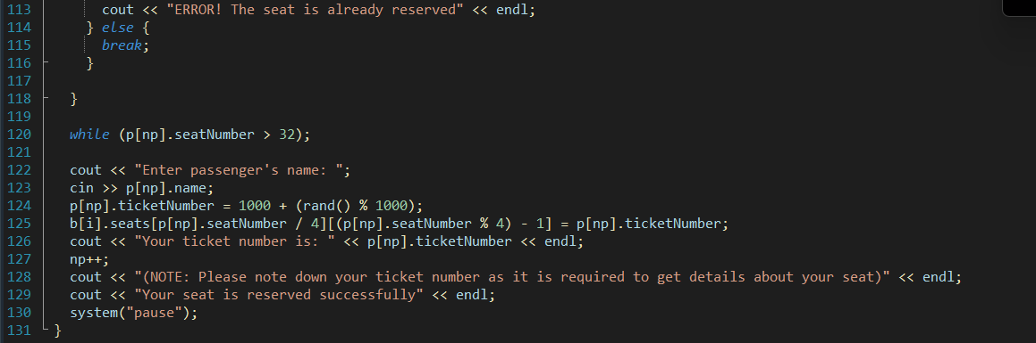

Slide 10
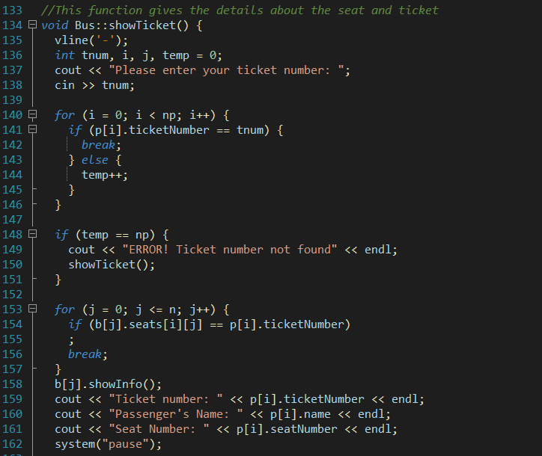

Slide 11
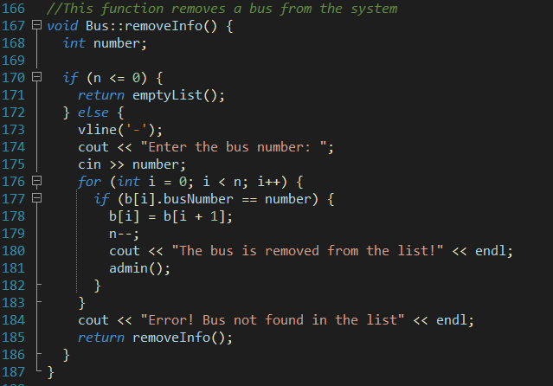

Slide 12
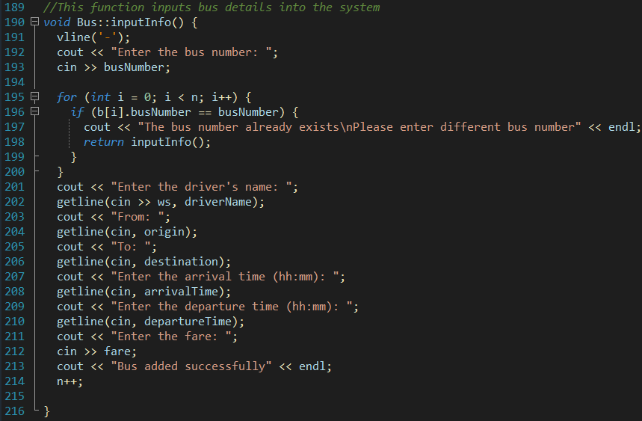

Slide 13
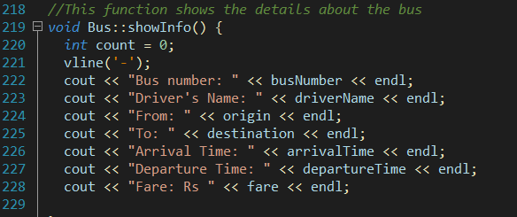

Slide 14
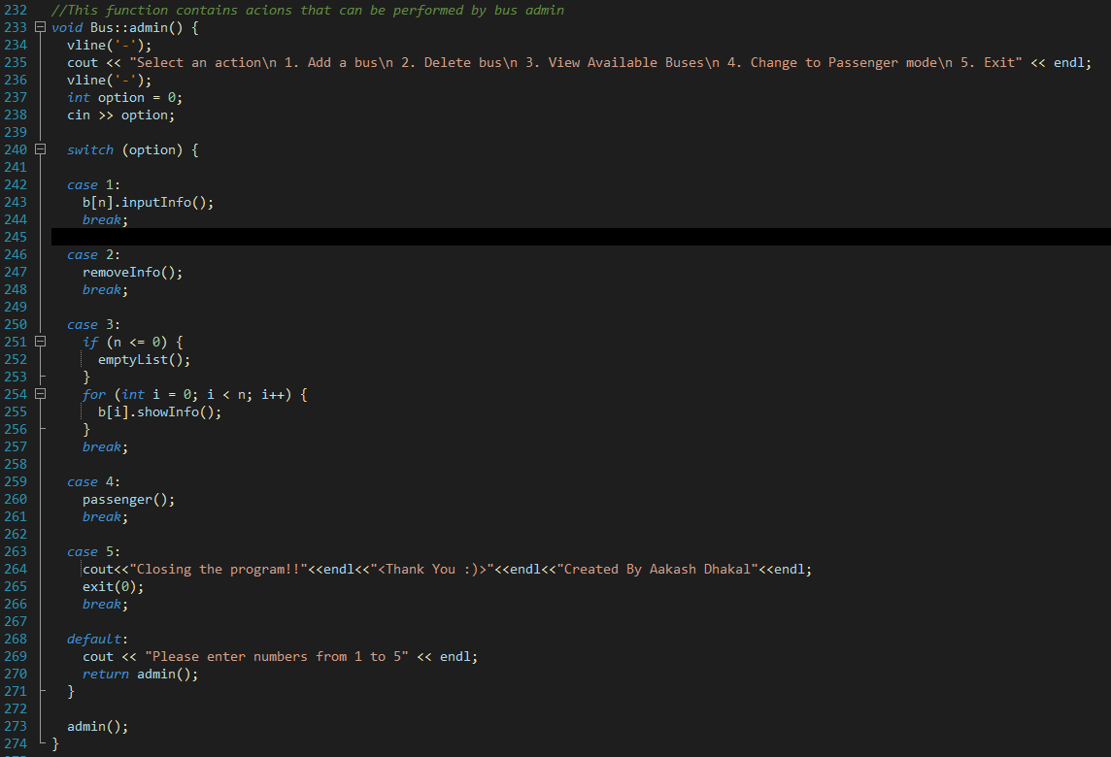

Slide 15
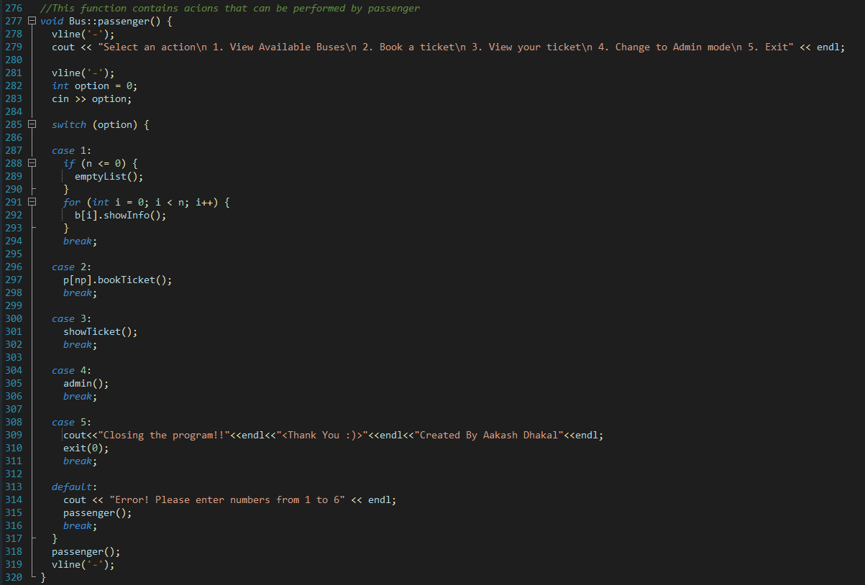

Slide 16
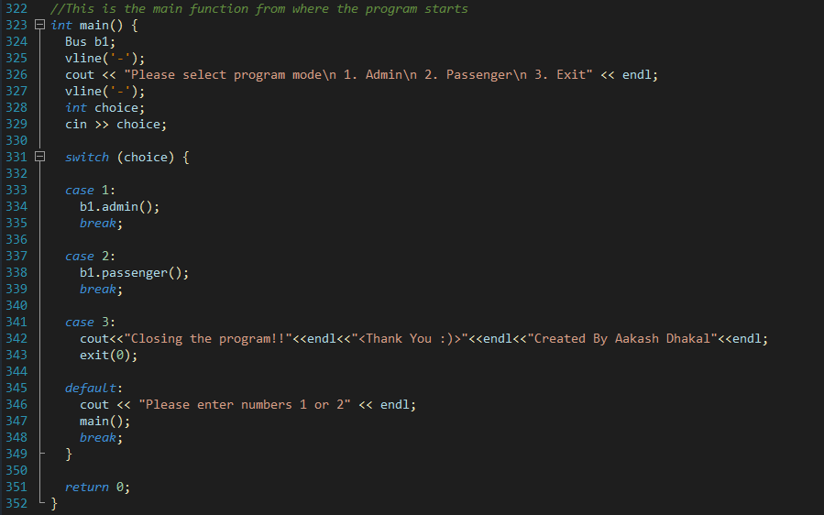

Slide 17
conclusion
Hence the bus ticket reservation and management program was created using C++ programming language with all features working as intended.

Slide 18
Any questions??

